Slide 1
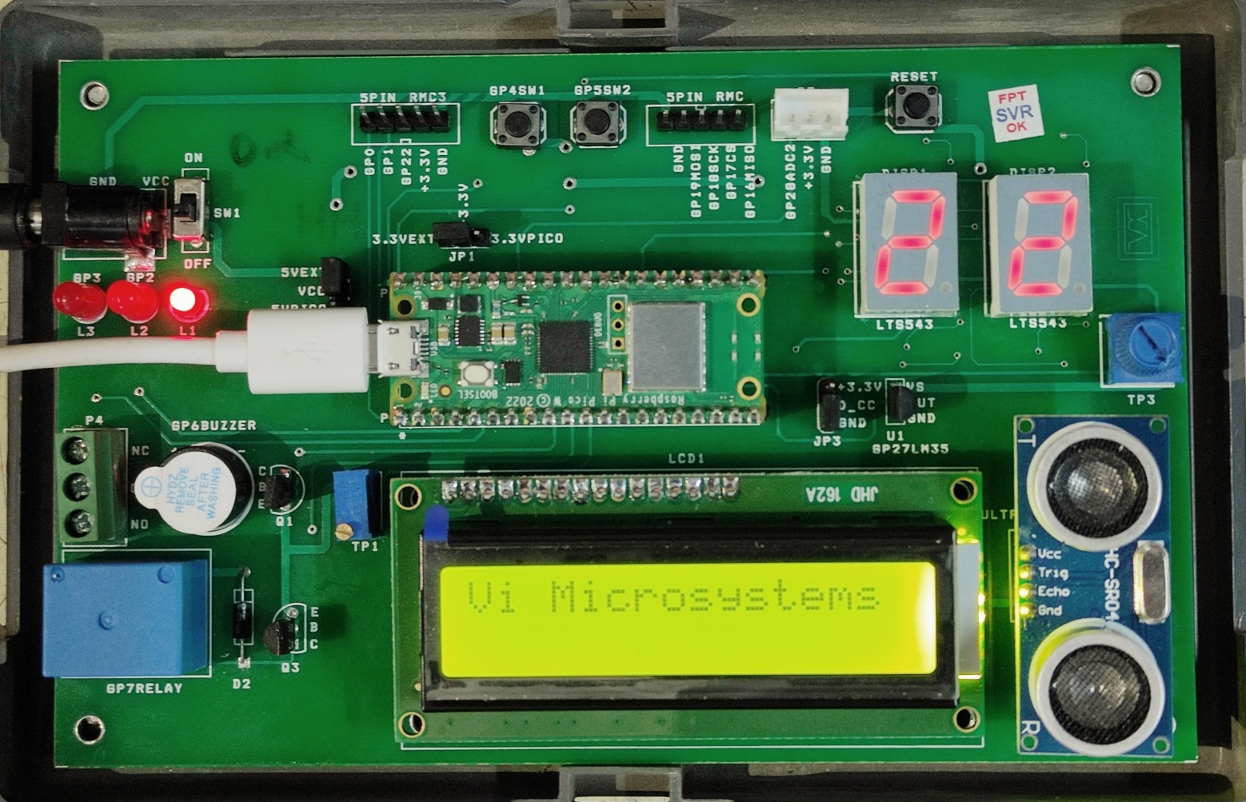
RP2040 - Microcontroller
RP2040 Carrier Board – VI Microsystems
Dr. K. Rajasekaran

Slide 2
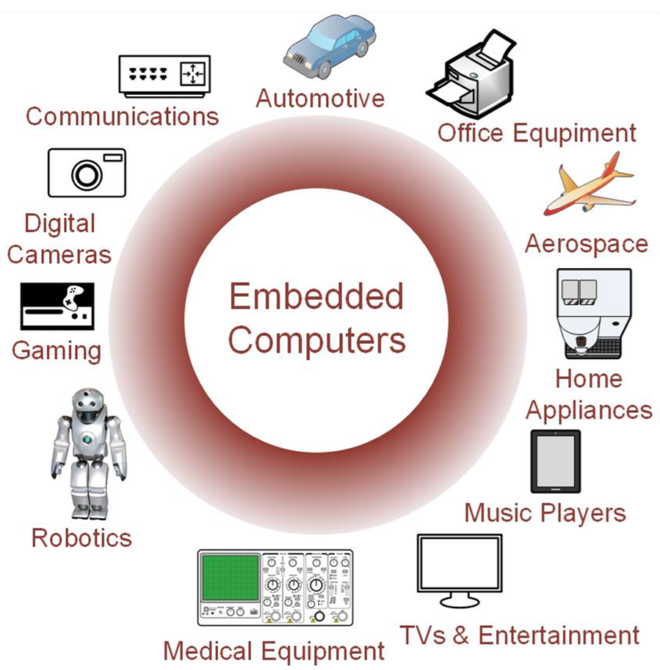
Why Learn Embedded Systems?
Embedded systems are the foundation of modern technology, empowering virtually every industry.
Embedded systems knowledge is no longer a niche skill but a necessity.
Opportunities in:
IoT (Internet of Things) – smart devices, home automation
Automotive industry – car safety, infotainment, electric vehicles (automotive embedded systems course)
Healthcare – medical monitoring equipment
Consumer electronics – mobiles, smart TVs, wearables

Slide 3
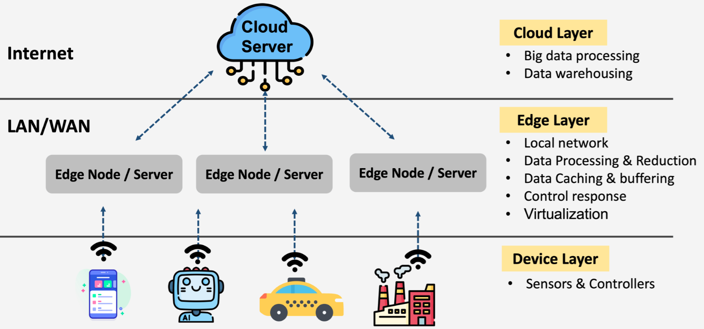
Internet of Things
The role of embedded systems within the Internet of Things (IoT), and the Industrial Internet of Things (IIoT), has grown and has enabled new levels of smart technology and interconnected ecosystems.
Further, IoT enables edge devices to interact and respond to real-world events and conditions, supporting context-aware decision-making and enhancing overall system intelligence.
IoT also allows for distributed computing and decentralized data processing, reducing the burden on centralized cloud infrastructure
By enabling strong communication and collaboration between edge devices, IoT facilitates data collection at the edge.
IoT ensures efficient interconnection and data exchange among numerous devices at the edge.

Slide 4
Key Layers of IoT Architecture
Perception/Sensing Layer : Acquiring raw information from physical environments to provide input for Analysis by higher levels.
Connectivity/Network Layer : Uses HTTP, MQTT and AMQP :
Internet gateways which allow communication outside local systems,
Intranet ports providing internet gateway and access points on these local systems,
Network gateways connecting multiple devices at once through bridging functions
Data Processing Layer :
It can process raw information from IoT systems through machine learning algorithms in order to retain useful details that are used for automated decision-making.
Edge analytics alongside AI techniques also form part of this stage which helps filter out irrelevant or unusable device info before Analysis.
User Interface/Application Layer : Humans to interact with the system and access specific services.

Slide 5


Slide 6
Predictions for the role of embedded systems in IOT
Greater IoT integration: It’s enabling seamless communication from one part of a network to another, and supporting data processing in real time.
Edge artificial intelligence refers to the deployment of AI algorithms and AI models directly on local edge devices such as sensors or Internet of Things (IoT) devices, which enables real-time data processing and analysis without constant reliance on cloud infrastructure.
AI revolution: AI is empowering embedded devices with the capability to make decisions in real-time, thanks to highly advanced algorithms and developments in neural networks.
Convergence between AI and embedded systems will have a huge effect on personalization, response and user experience in a huge number of applications and industries.

Slide 7
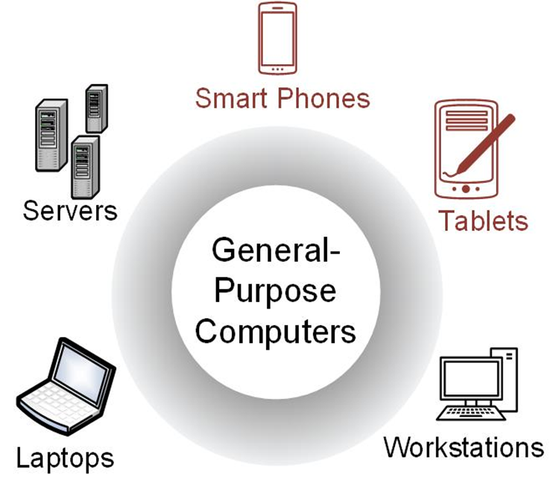
General-Purpose Computers
Able to run a variety of software.
Contain relatively high-performance hardware components (fast processors, data & program storage).
Require an operating system (OS).
Designed for heavy user interaction.
Uses a variety of peripherals (displays, keyboards, mice, internet connections, wireless communication capability).

Slide 8
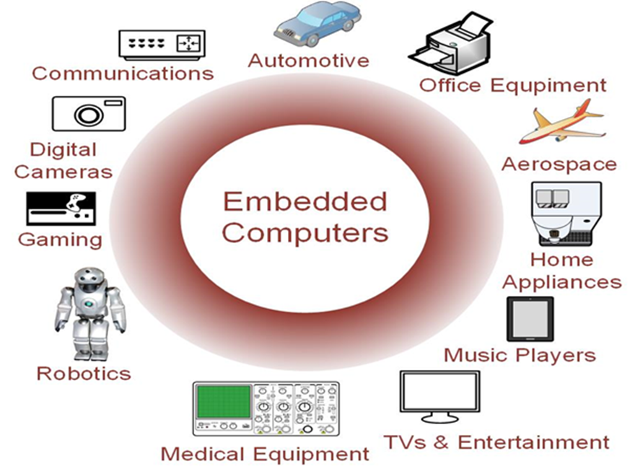
Embedded Computers
Contains firmware (only the needed software which is not intended to be changed frequently).
Resources can be implemented on a single and low-cost IC.
Include a variety of peripherals (timers, analog-to-digital converters, digital-to-analog converters, serial interfaces).
Small size makes them very versatile.
Real-time system is the one in which logical correctness is based on both the correctness of the output as well as their timeliness.
Typical interaction in an RTS is asynchronous or periodic (interrupt handlers and dispatcher and associated resources).

Slide 9
Parts of an Embedded System
USER
EMBEDDED SYSTEM
I/O
MEMORY
PROCESSOR
SENSORS
ACTUATORS
HARDWIRED UNIT
Application-specific logic
Timers
A/D and D/A conversion
ENVIRONMENT

Slide 10
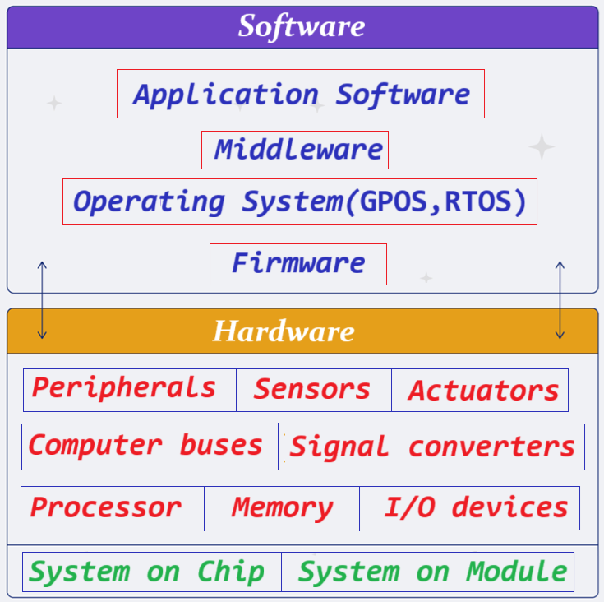

Slide 11
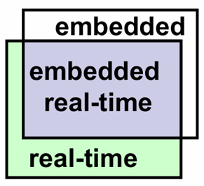
Characteristics of Embedded Systems
Application specific
Efficient
energy, code size, weight and cost
Dependable
Reliability, maintainability, availability, safety, security
Real-time constraints
Soft vs. hard
Reactive - connected to physical environment
sensors & actuator
Hybrid: Analog and digital
Distributed
Composability, scalability, dependability
Dedicated user interfaces

Slide 12
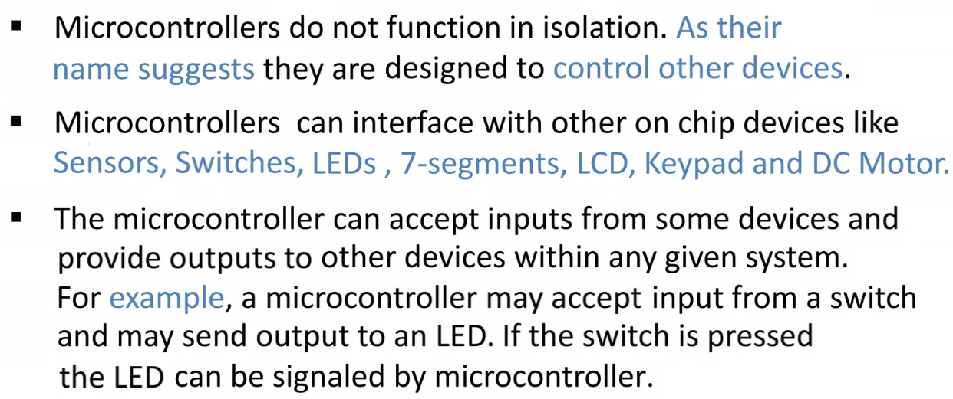
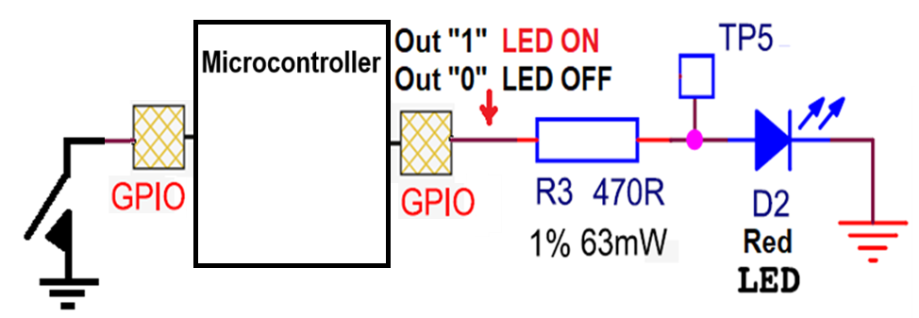

Slide 13
What is Raspberry Pi RP2040?
The Raspberry Pi RP2040 is a microcontroller designed by Raspberry Pi. Unlike Raspberry Pi boards − a single-board computer.
The RP2040 − a microcontroller,
programmed to perform specific tasks and
can run for years on a single battery.
The RP2040 is based on a dual-core ARM Cortex-M0+ processor − it’s powerful enough to handle a wide range of applications.

Slide 14
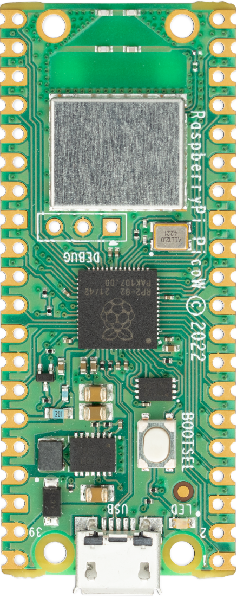
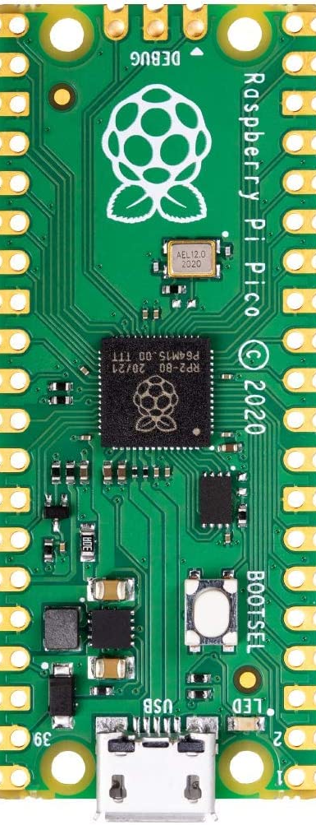
Raspberry Pi PICO Boards
Salient Features : -
PICO
PICO-W
Inexpensive board for embedded applications
Programming Pico board : –
MicroPython with Thonny, the Python IDE
C/C++ &
Assembly Languages
Raspberry Pi Pico supports a variety of embedded courses.
RP2040
RP2040

Slide 15
Why is the Raspberry Pi RP2040 a Game-Changer?
It’s incredibly affordable, with prices starting at just $1.
It’s incredibly powerful, yet the most energy-efficient microcontroller.
The MicroPython programming language support.
Programmable I/O (PIO), a flexible I/O enables Raspberry Pi Pico to talk to almost any external device.
A good platform for endpoint AI: TinyML - to run machine learning (ML) models to do sensor-based analysis such as
voice and image recognition and
accelerometer-based gesture recognition.

Slide 16
Raspberry Pi PICO Board
RP2040 Microcontroller
Dual ARM Cortex-M0+ cores. Clock frequency up to 133 MHz. SRAM (264 kB)
DMA
Bus Master
WRITE
DMA
Bus Master
READ
CORE 0
CORE 1
DMA bus masters can be used to off-load repetitive data transfer tasks from the processors.
GPIO
GPIO
Four GPIO pins are used for internal board functions
PIO
Flexible and configurable PIO controllers can be used to provide a wide variety of IO functions.
SIO
SPI
26+4 GPIO Pins
The Single-cycle IO block (SIO) contains several peripherals that require low-latency, deterministic access from the processors including GPIO pins.
I2C
3 are ADC capable inputs which are shared with GPIO pins.
PWM
UART
ADC
2 GB Flash Memory
(Onboard)
QSPI

Slide 17
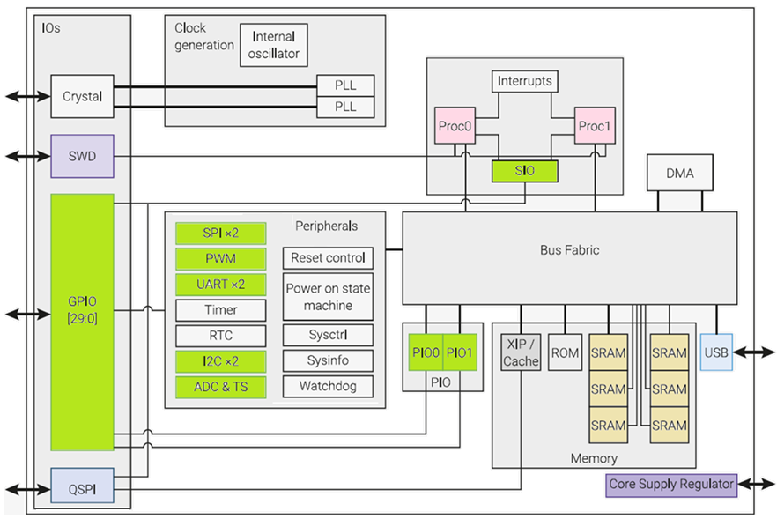
RP2040 Microcontroller - Architecture
RP2040 Microcontroller
The RP2040 processor consists of two Arm Cortex-M0+ processors — each with its standard internal Arm CPU peripherals
Notes:
RP2040 Microcontroller – Introduction
Dual ARM Cortex-M0+ cores with clock frequency up to 133 MHz
Code may be executed directly from external memory (2MB of on-board Flash memory) through a dedicated SPI.
Debug is available via the SWD interface.
Internal SRAM (264 kB) can contain code or data. It is physically partitioned into 6 banks to allow simultaneous parallel access from different masters.
DMA bus masters are available to offload repetitive data transfer tasks from the processors.
GPIO pins can be driven directly, or from a variety of dedicated logic functions.
Dedicated peripheral hardware for fixed functions such as SPI, I2C, UART.
Flexible configurable PIO controllers can be used to provide a wide variety of IO functions.
12-bit, SAR, 500ksps, ADC with Four ADC inputs which are shared with GPIO pins and One input is dedicated to the internal temperature sensor.
Two PLLs to provide a fixed 48MHz clock for USB or ADC, and a flexible system clock up to 133MHz.

Slide 18
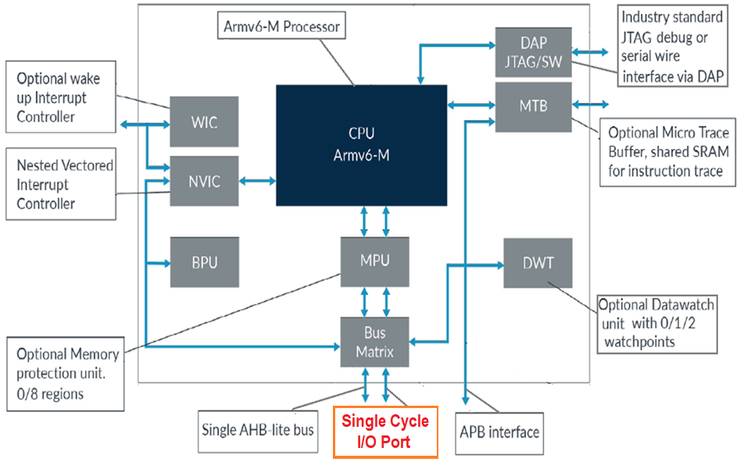
Cortex-M0+ processor features and benefits are:
• High code density with 32-bit performance.
• Support for Single-cycle I/O access, can perform rapid 32-bit reads and writes in single clock cycle.
• Power control optimization of system components.
• Integrated sleep modes for low-power consumption.
• Optimized code fetching for reduced power consumption.
• Hardware multiplier.
Deterministic, high-performance interrupt handling for time-critical applications.
Deterministic instruction cycle timing.
Notes:
Cortex-M0+ Processors - Features
The Cortex-M Processors are configurable designs with a number of parameters that chip designers can select.
Chip designers can omit some of the features that are unnecessary for their projects to save power and reduce silicon area.
The Cortex-M0+ (32-bit RISC ) processor.
It has an AMBA AHB-Lite interface and single-cycle I/O interfacing.
The ARM Cortex-M0+ processor brings 32-bit power at an 8-bit Cost.
Has the Smallest Footprint & Lowest Power requirements, consumes just 9µA/MHz on a low-cost 90nm LP process, around one third of the energy of any 8- or 16-bit processor available today, while delivering significantly higher performance.
The low-power processor is suitable for a wide variety of applications, including sensors and wearables.
Single-cycle IO to speed access to GPIO and peripherals.
Improved debug and trace capability and a 2-stage pipeline.
The exceptional code density of Cortex-M0+ significantly reduces memory requirements, ideal for use in wearables for healthcare, fitness, and more.
With its three highly optimized low-power modes, the processor conserves energy to match processing demands.

Slide 19
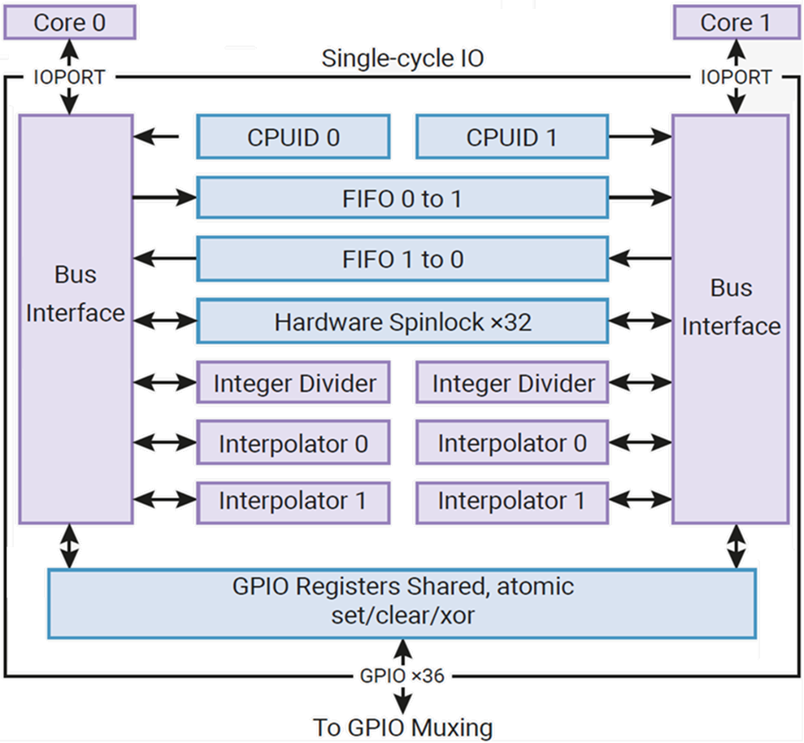
Single-Cycle IO Block
The FIFOs support Message passing between the two cores.
SIO has two separate FIFOs for the cores to communicate with each other.
Spinlocks for Synchronisation between the two cores.
If both cores try to claim the same lock on the same clock cycle, core 0 succeeds.
A lock is acquired by polling the lock bit.
Spinlocks should be used to protect the short critical sections of higher-level primitives such as mutexes, semaphores and queues.
Integer Divider is an 8-cycle signed/unsigned divide/modulo circuit, per core. A 'ready' bit in register DIV_CSR can be polled to wait for the calculation to complete, or software can insert a fixed 8-cycle delay.

Slide 20
RP2040 Integrated Development Environment with Hands-on Experience

Slide 21
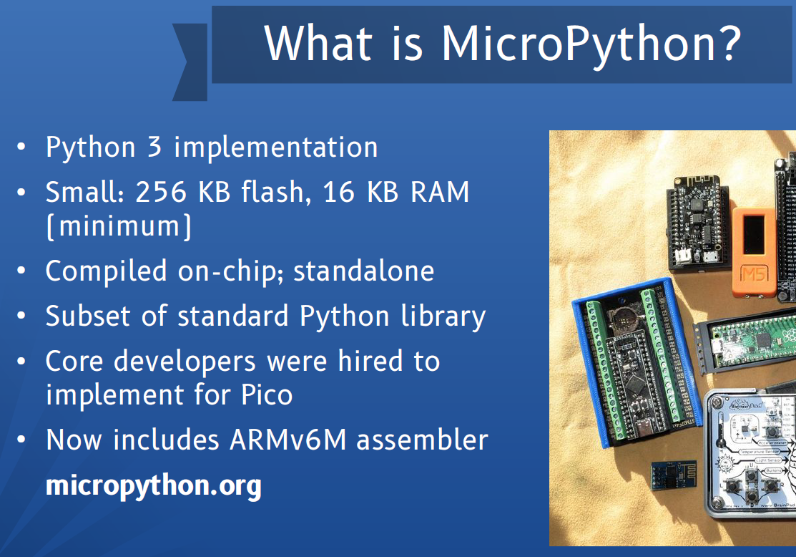

Slide 22
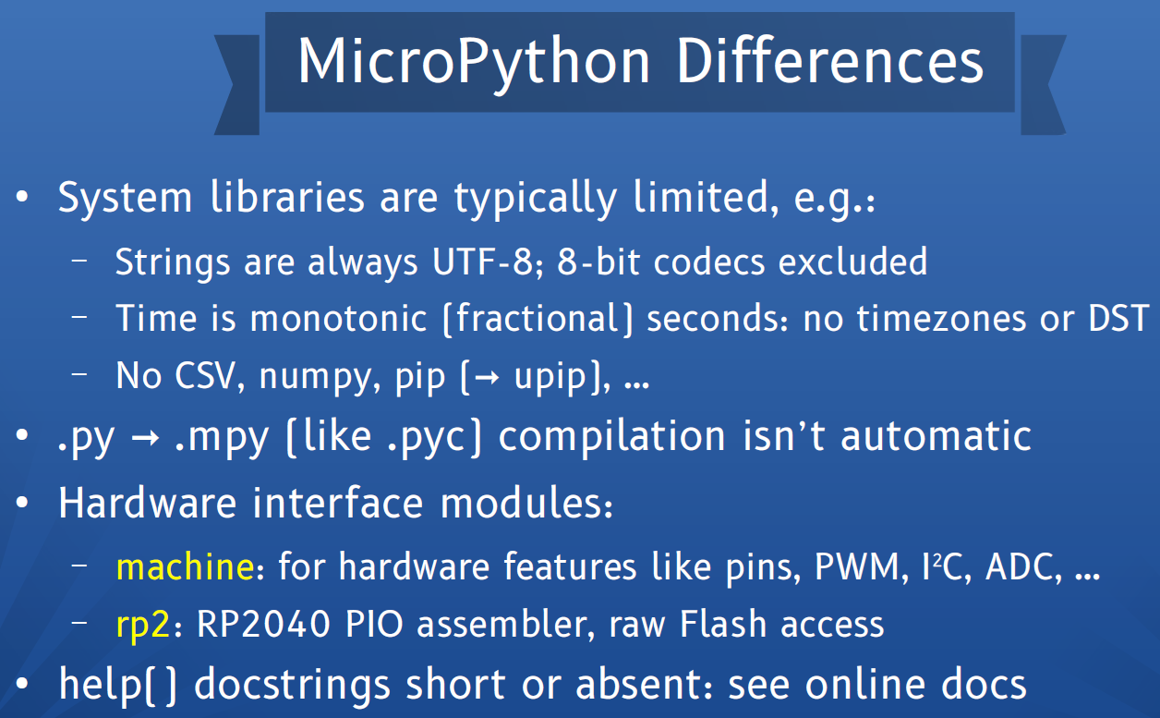

Slide 23
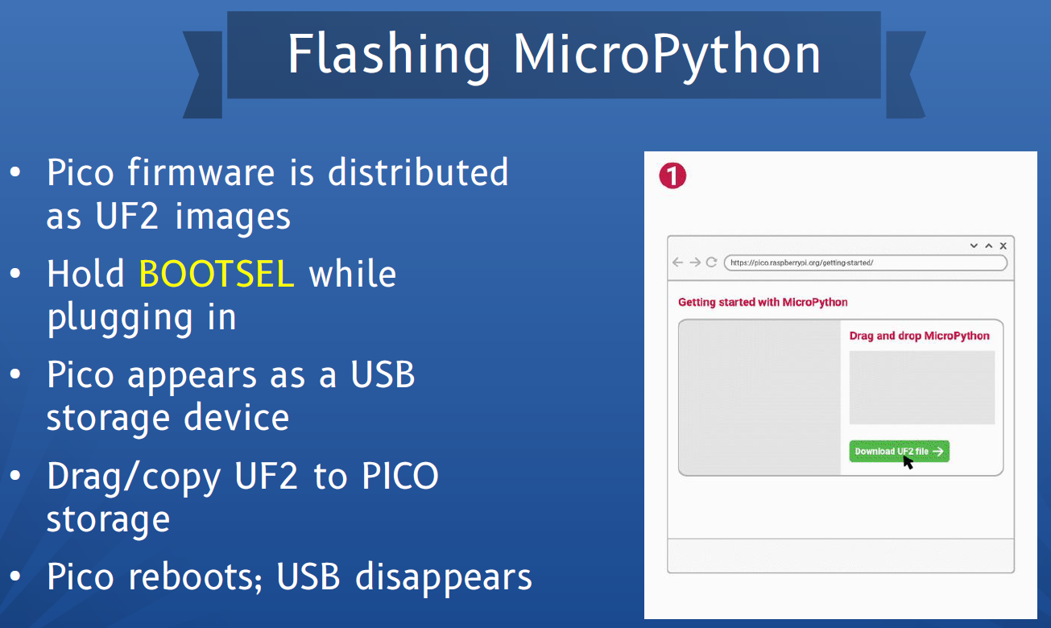

Slide 24
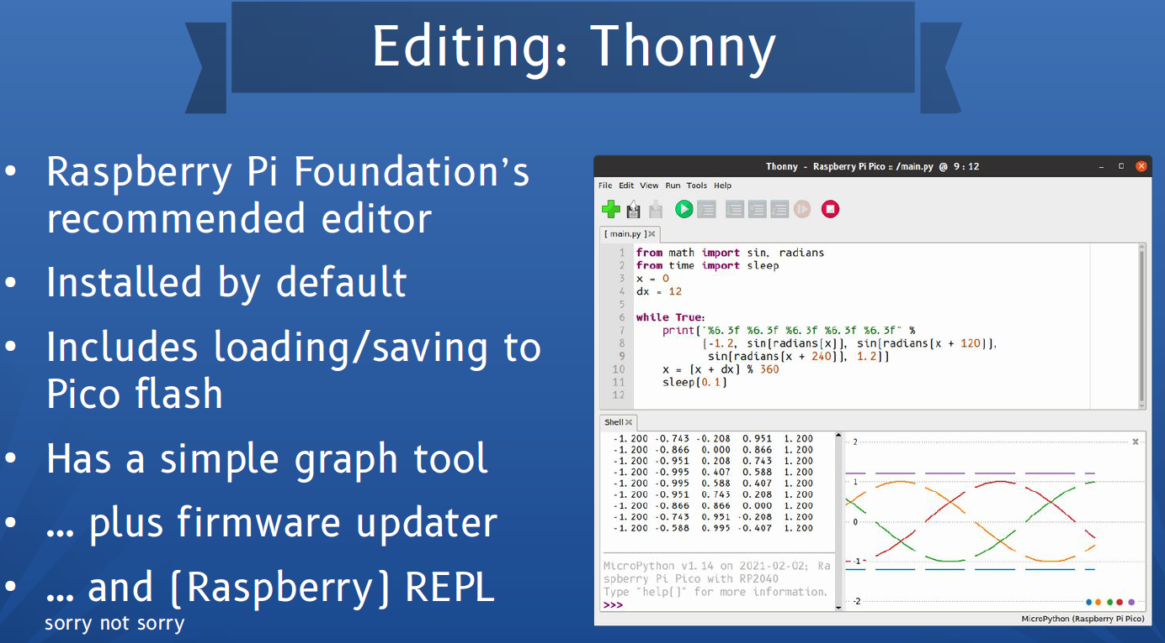

Slide 25
RP2040 Microcontroller - GPIO

Slide 26
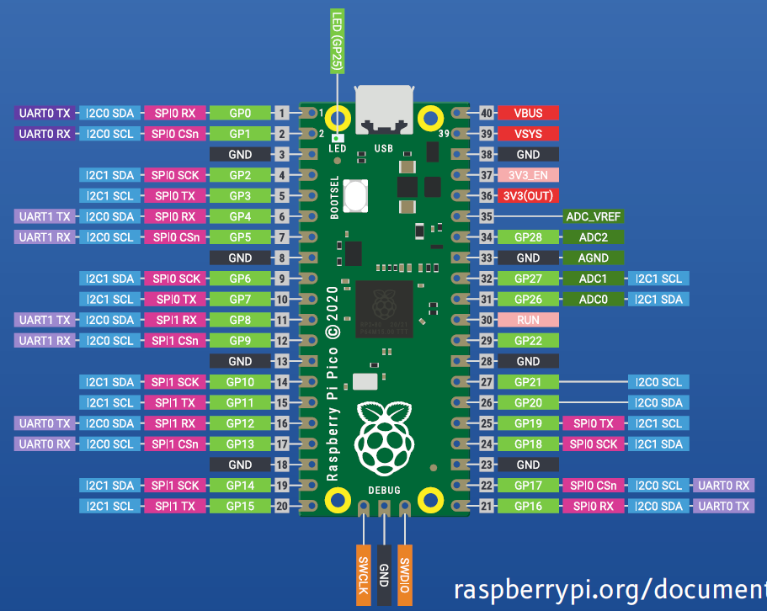

Slide 27
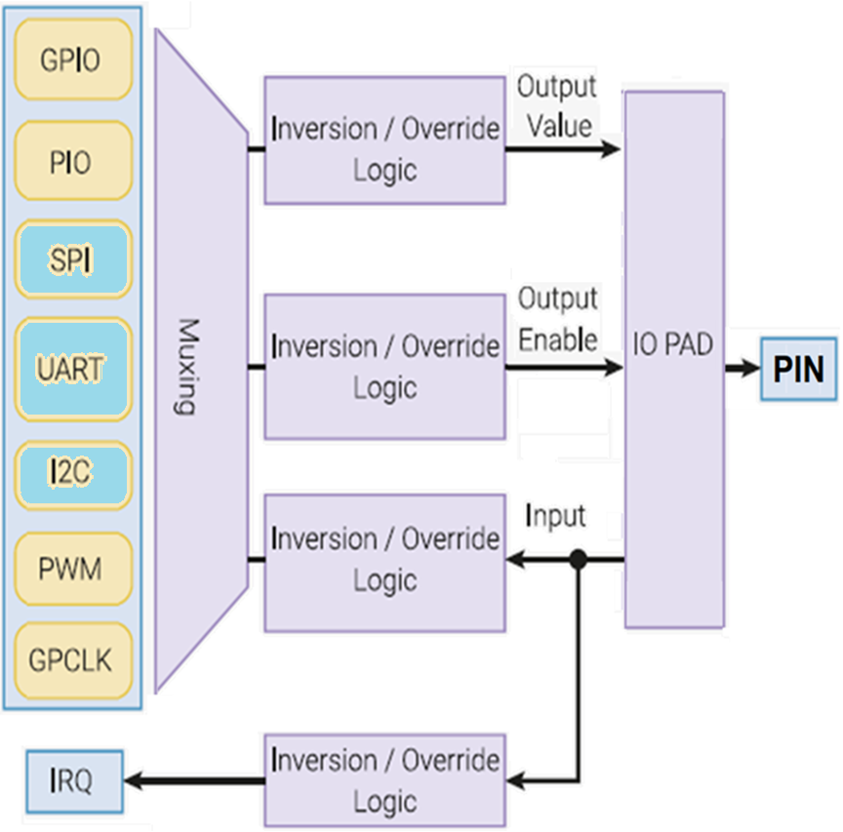
Logical structure of an example IO
The figure shows the logic structure of a Pin, highlighting the various parts of the microcontroller that can be connected to it:
Each GPIO is connected to the off-chip world via a "pad".
Pads are the electrical interface between the chip’s internal logic and external circuitry.
An IO Pad can have multiple functions.
They translate signal voltage levels, support higher currents and offer some protection against electrostatic discharge (ESD) events.

Slide 28
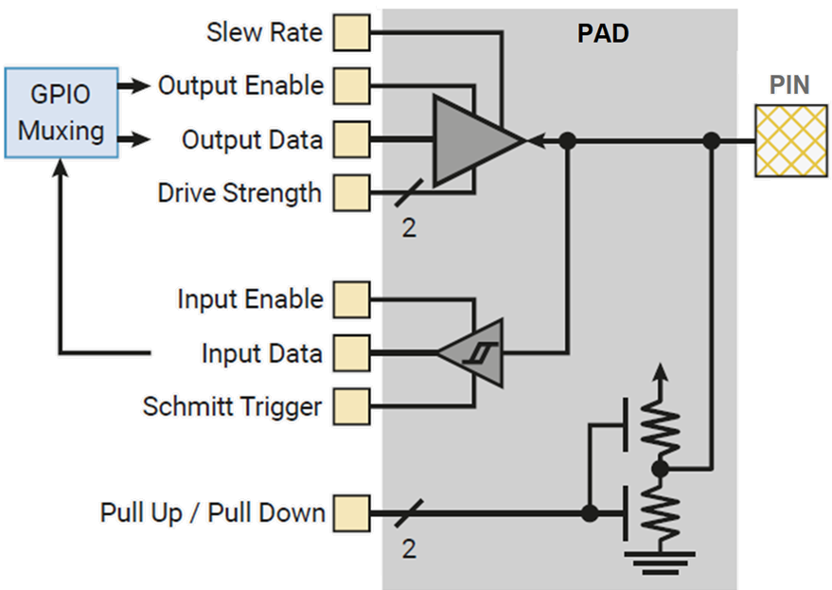
GPIO (Pads)
"IO PAD" represents the electrical interface between the internal logic and the actual pin:
Output slew rate can be set to slow or fast.
Output drive strength can be set to 2mA, 4mA, 8mA or 12mA.
Input hysteresis (Schmitt trigger mode) can be enabled.
A pull-up or pull-down can be enabled, to set the output signal level when the output driver is disabled.
The input buffer can be disabled, to reduce current consumption when the pad is unused, unconnected or connected to an analogue signal.

Slide 29
Hands-on Session

Slide 30
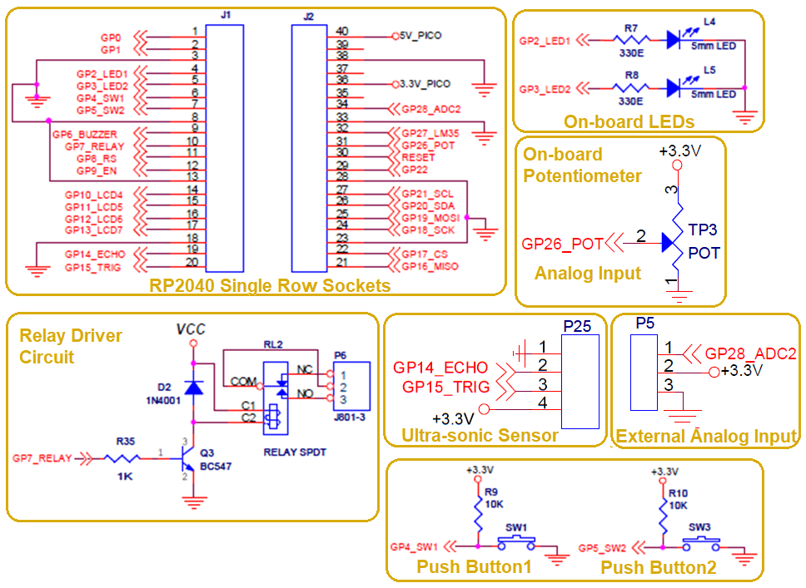
RP2040 Carrier Board – VI Microsystems

Slide 31
Pins and GPIO
Delay and timing
Use the machine.Pin class:
from machine import Pin
p0 = Pin(0, Pin.OUT) # create output pin on GPIO0
p0.on() # set pin to "on" (high) level
p0.off() # set pin to "off" (low) level
p0.value(1) # set pin to on/high
p1 = Pin(5, Pin.OUT, value=1) # set pin high on creation
p2 = Pin(2, Pin.IN) # create input pin on GPIO2
print(p2.value()) # get value, 0 or 1
p3 = Pin(4, Pin.IN, Pin.PULL_UP) # enable internal pull-up resistor
Use the time module:
import utime
utime.sleep(1) # sleep for 1 sec.
utime.sleep_ms(500) # sleep 500ms
utime.sleep_us(10) # sleep for 10μs
start = utime.ticks_ms() # get millisecond counter
delta = utime.ticks_diff(time.ticks_ms(), start) # compute time difference

Slide 32
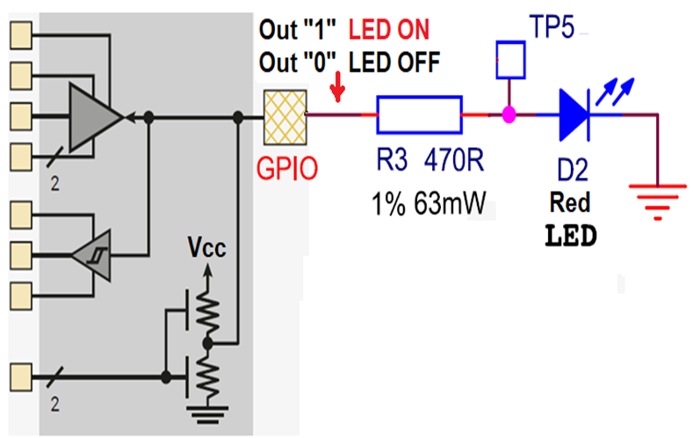
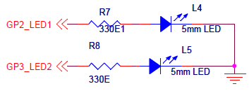
Pi Pico GPIO - LED Interfacing using MicroPython
Prog-1
from machine import Pin
from time import sleep
L1 = Pin("LED", Pin.OUT) # On-board LED (GP25)
L2 = Pin(2, Pin.OUT) # On-Kit LED (GP2_LED1)
L3 = Pin(3, Pin.OUT) # On-Kit LED (GP2_LED2)
while True:
L1.toggle()
#L2.toggle()
#L3.toggle()
sleep(1)
On-board LED

Slide 33
Pi Pico GPIO - LED Interfacing using MicroPython
Prog-2
from machine import Pin
from time import *
L1 = Pin("LED", Pin.OUT) # On-board LED (GP25)
L2 = Pin(2, Pin.OUT) # On-Kit LED (GP2_LED1)
L3 = Pin(3, Pin.OUT) # On-Kit LED (GP2_LED2)
while True:
x=19 # Give any value from 0 to 19
#L1.value(1)
#L2.value(1)
L3.value(1)
#sleep_ms(100) # Delay 0.1 second
sleep_ms(x) # Delay x second
#L1.value(0)
#L2.value(0)
L3.value(0)
#sleep_ms(100) # Delay 0.1 second
sleep_ms(20-x) # Delay (20-x) msecond

Slide 34
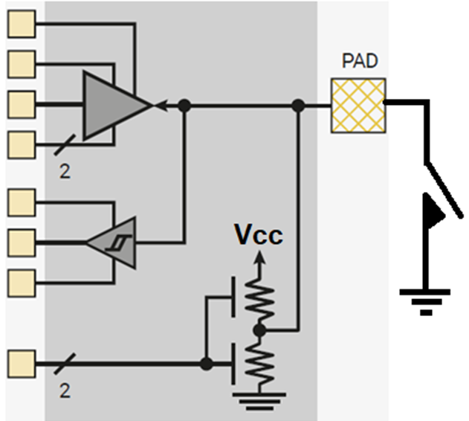
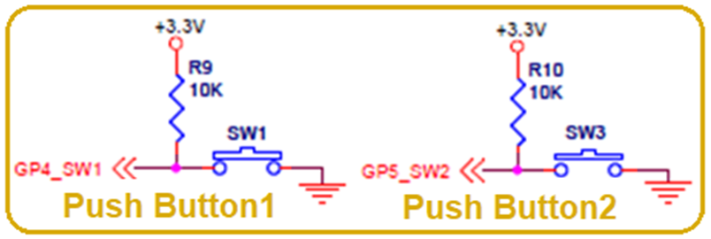
Pi Pico GPIO – Push Button Interfacing using MicroPython
Prog-3
from machine import Pin
from time import sleep
L1 = Pin("LED", Pin.OUT) # On-board LED (GP25)
L2 = Pin(2, Pin.OUT) # On-Kit LED (GP2_LED1)
L3 = Pin(3, Pin.OUT) # On-Kit LED (GP2_LED2)
push_button1 = Pin(4, Pin.IN, Pin.PULL_UP) # GPIO 4 pin is input GP4_SW1
push_button2 = Pin(5, Pin.IN, Pin.PULL_UP)# GPIO 5 pin is input GP5_SW2
while True:
#L1.value( not push_button1.value())
if (not push_button1.value()):
L1.value(1)
sleep(0.15)
L1.value(0)
sleep(0.15)

Slide 35
RP2040 Timers

Slide 36
Raspberry Pi Pico Timers
Previously we learned how to blink an LED using sleep() function. Hardware Timers, deal with timing of periods and events, are more efficient than using the sleep function because they are not blocking functions.
A blocking function stops the program from performing any task until the previous one is completed. For example, the sleep() function, when we call sleep(2), our program stops at this line for 2 seconds, and thus it acts as a blocking function.
This is not the case for Timers. To perform multiple tasks at once we prefer to use timers and should avoid using delays because they waste processing time.

Slide 37
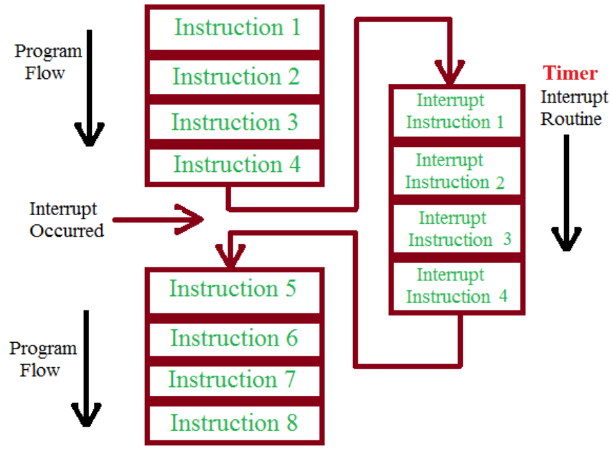
Timer Interrupt
For example, we can use a timer interrupt to toggle the LED after every one second.
When a timer interrupt occurs, it stops the sequential execution of the program and performs a task that is attached to a respective time interrupt.
After completing the interrupt service routine, the program returns to the next instruction from where it left off.

Slide 38
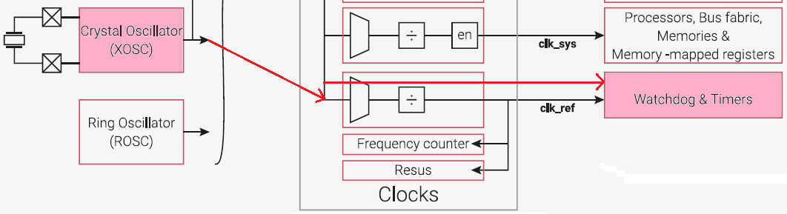
RP2040 Timers
• Timers are counters that count pulses from a timebase.
• The RP2040 system timer has 64-bit resolution and provides a global microsecond time base – overflows after a thousand years!
• The RP2040 has 4 programmable alarms of 32 bits that can generate interrupts (TIMER_IRQ0, …, TIMER_IRQ_3). Max alarm duration is 232 microseconds ~ 72 minutes

Slide 39
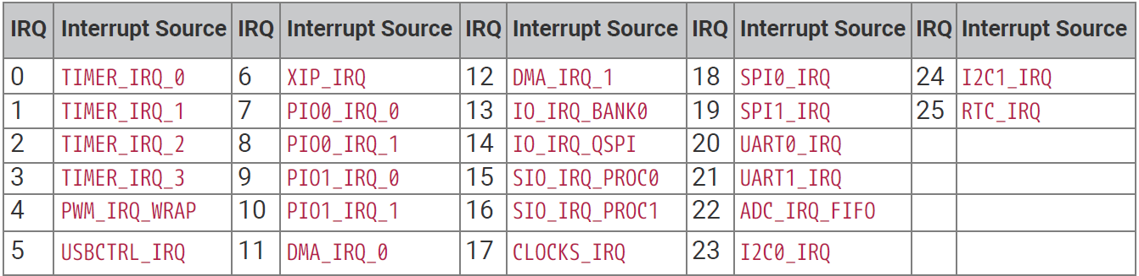
Nested Vectored Interrupt Controller (NVIC)
NVIC features are:
26 external interrupt inputs, each with four levels of priority.
Dedicated Non-Maskable Interrupt (NMI) input (which can be driven from any standard interrupt source)
Support for both level-sensitive and pulse-sensitive interrupt lines.
Wake-up Interrupt Controller (WIC), providing ultra-low power sleep mode support.
Relocatable vector table.

Slide 40
Timer Interrupt - Examples
To detect changes in some I/O pins.
To detect timer events (overflow, compare with threshold)
To grab the value of a completed ADC acquisition.
To grab when data arrives to communication channels (USART, SPI, I2C).
When the interrupt occurs, the microcontroller:
– completes the current instruction,
– stores the address of the following instruction
– and jumps to an Interrupt Service Routine (ISR) provided by
the programmer to process the interrupt. The pointer to
this routine is stored in the ISR Vector Table.
• When the ISR completes, the processor returns to the point where it was interrupted.

Slide 41
Other Programmable Counter Resources
RP2040 has a number of other programmable counter resources which can provide regular interrupts, or trigger DMA transfers.
The PWM contains 8× 16-bit programmable counters, which run at up to system speed, can generate interrupts, and can be continuously reprogrammed via the DMA, or trigger DMA transfers to other peripherals.
8× PIO state machines can count 32-bit values at system speed, and generate interrupts.
The DMA has four internal pacing timers, which trigger transfers at regular intervals.

Slide 42
Raspberry Pi Pico Timers - MicroPython Library
Import the machine module and from that module, import the Timer class:
from machine import Timer
Create an instance of a timer class with an object name.
Give any descriptive name to the timer class object such as “timer”.
The input argument to the timer() method is the ID of the timer:
For virtual timer, the ID is -1.
To use the single hardware timer of Raspberry Pi Pico can leave the ID empty .
Initialize the Timer() function with three arguments namely:
Period: The period of the interrupt signal in milliseconds. This is the total time until the callback is called.
Mode: To configure our Timer as periodic or in one shot. ‘Timer.PERIODIC’ or ‘Timer.ONE_SHOT.’
Callback: The Function which is executed whenever a timer is triggered. In periodic mode, the callback function will be called after every period specified.

Slide 43
Hands-on Session
Raspberry Pi Pico Timers

Slide 44
Raspberry Pi Pico Timer
Prog-4
from machine import Pin, Timer
from time import sleep
L1 = Pin("LED", Pin.OUT) # On-board LED (GP25)
L2 = Pin(2, Pin.OUT) # On-Kit LED (GP2_LED1)
L3 = Pin(3, Pin.OUT) # On-Kit LED (GP2_LED2)
push_button1 = Pin(4, Pin.IN, Pin.PULL_UP) # GPIO 4 pin is input GP4_SW1
push_button2 = Pin(5, Pin.IN, Pin.PULL_UP)# GPIO 5 pin is input GP5_SW2
tim = Timer() #create an instance of Timer method
def blink(t): #function which is toggling the led
if (push_button1.value()==0):
L1.toggle()
tim.init(freq=2, mode=Timer.PERIODIC, callback=blink)
while True: #Main Loop
L2.value(1)
sleep(1)
L2.value(0)
sleep(1)

Slide 45
Raspberry Pi Pico Multiple Timer
Prog-5
from machine import Pin, Timer
from time import sleep
L1 = Pin("LED", Pin.OUT) # On-board LED (GP25)
L2 = Pin(2, Pin.OUT) # On-Kit LED (GP2_LED1)
L3 = Pin(3, Pin.OUT) # On-Kit LED (GP2_LED2)
push_button1 = Pin(4, Pin.IN, Pin.PULL_UP) # GPIO 4 pin is input GP4_SW1
push_button2 = Pin(5, Pin.IN, Pin.PULL_UP) # GPIO 5 pin is input GP5_SW2
tim = Timer() #create an instance of Timer method
tim1 = Timer() #create an another instance of Timer
def blink(t): L1.toggle() #fn which is toggling the On-board LED
def blink1(t): L2.toggle() #fn which is toggling the On-Kit LED (GPIO2)
tim.init(freq=1, mode=Timer.PERIODIC, callback=blink)
tim1.init(period=100, mode=Timer.PERIODIC, callback=blink1)
#Main Loop
while True:
L3.value(1)
sleep(1)
L3.value(0)
sleep(1)

Slide 46
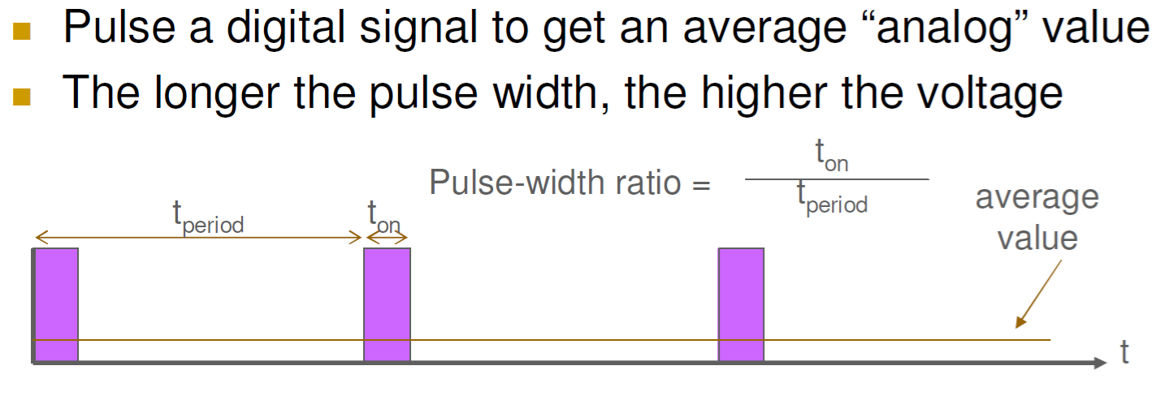

Slide 47
PWM (pulse width modulation)
Pulse width modulation (PWM) is a scheme where a digital signal provides a smoothly varying average voltage. This may be used to approximate an analog output, or control switch mode power electronics.
Duty Cycle = ON time of signal / (ON time + OFF time) of signal, Time Period = ON time + OFF time
Duty Cycle = ON time of signal / Time period of signal
Frequency = 1/Time Period
The RP2040 PWM block can be used to generate PWM output signals or measure the frequency or duty cycle of an input signal.
The RP2040 PWM block has 8 identical slices.
Each slice can drive two PWM output signals making it 16 PWM channels in total which can be clocked from 7Hz to 125Mhz.
All 30 GPIO pins can be driven by the PWM block.

Slide 48
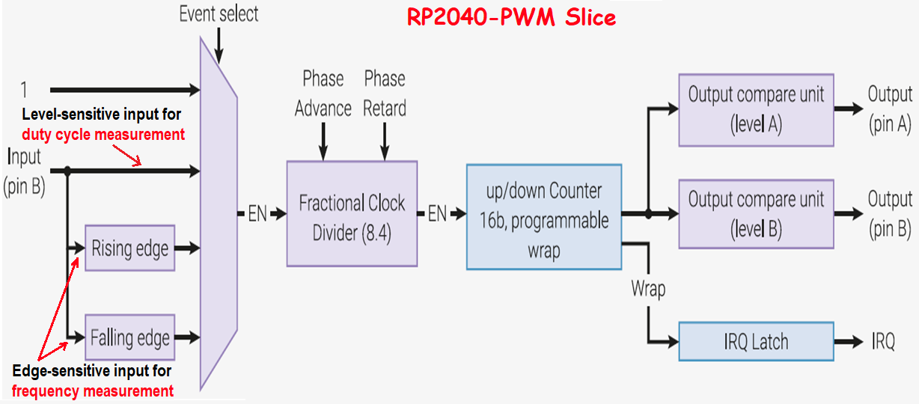
16-bit counter, 8.4 fractional clock divider
Two independent output channels, duty cycle from 0% to 100% inclusive
Dual slope and trailing edge modulation. Interrupt and DMA request on counter wrap
Wrap and level registers are double buffered and can be changed race-free while PWM is running
Phase can be precisely advanced or retarded while running (increments of one count)
Slices can be enabled or disabled simultaneously via a single, global control register enabling the slices to run in perfect lockstep.

Slide 49
MicroPython LED Fading Example using PWM
Steps to follow in order to use the PWM module in RP2040:
Importing the Pin & PWM class. from machine import Pin, PWM
Choose the PWM pin. Creating a PWM pin object for the LED. pwmObject.PWM(Pin(2)) #shows the PWM is connected on GPIO2.
Set a particular frequency for PWM digital signal. 1000Hz is a good value to start off with to work with an LED: pwmObject.freq(1000)
Raspberry Pi Pico has 12 bit resolution but in MicroPython it is scaled to 16 bits. Hence the duty cycle will be set from 0-65535 which corresponds to 0-100%. To set the duty cycle for the PWM signal. pwmObject.duty_u16(duty)
pwm0 = PWM(Pin(0)) # create PWM object from a pin
pwm0.freq() # get current frequency
pwm0.freq(1000) # set frequency
pwm0.duty_u16() # get current duty cycle, range 0-65535
pwm0.duty_u16(200) # set duty cycle, range 0-65535
pwm0.deinit() # turn off PWM on the pin

Slide 50
Hands-on Session

Slide 51
MicroPython LED Fading Example using PWM
Prog-6
from machine import Pin, PWM
from time import sleep
L2 = PWM(Pin(2))
L3 = PWM(Pin(3))
L2.freq(100)
L3.freq(100)
while True:
for duty in range(0,65535):
L2.duty_u16(duty)
L3.duty_u16(65535-duty)
sleep(0.0001)
sleep(1)
for duty in range(65535,0,-1):
L2.duty_u16(duty)
L3.duty_u16(65535-duty)
sleep(0.0001)
sleep(1)

Slide 52
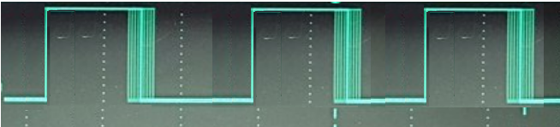
Real Time Issues (High speed I/O)
from machine import Pin, Timer
sig=Pin(28,Pin.OUT)
while (1):
sig.value(1)
sig.value(0)

Slide 53
This jitter arises from several factors:
Instruction execution:
A single instruction may take several clock cycles.
A high-level language function call like sig.value() can involve multiple assembly instructions, such as loading the pin's memory address, preparing the value, and storing it.
Loop overhead:
The while(1) loop also has overhead. At the very least, it includes a jump instruction to go back to the top of the loop.
Conclusion:
With a 100 MHz processor, the toggling frequency produced by this Micropython code would likely be between 10 and 25 MHz,

Slide 54
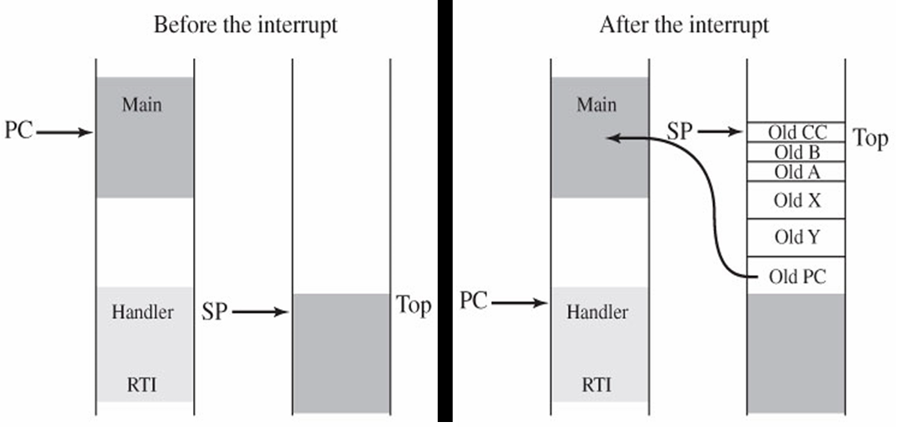
This jitter arises from several factors: (Contd…)
Interrupts and Background Tasks:
The microcontroller may be handling interrupts (even if not explicitly programmed by the user) which can momentarily delay the execution of the led.value() commands, causing slight variations in the timing of the high and low states.
Int

Slide 55
This jitter arises from several factors:
Microcontroller Execution Time:
Even simple instructions take a small amount of time to execute on the microcontroller. The exact time can vary slightly due to internal operations, interrupts, or other background processes.
Lack of Explicit Delays:
The absence of any utime.sleep() or similar delay functions means the code is executing as fast as the microcontroller can manage. In such high-speed scenarios, even minor variations in execution time become more apparent as jitter.
Consequences of Jitter:
Jitter might can be a significant concern in applications requiring precise timing, such as:
Communication Protocols: Jitter can disrupt data integrity in serial communication, I2C, or SPI.

Slide 56
Real Time Issues (High speed I/O)
To get faster i/o you need to use hardware and not python/C/Assembly loops.
A very interesting feature of this chip is an 8-way parallel, hardware, state machine dedicated to fast i/o processing.
Each of the 8 processors can run simple, deterministic, assembler programs

Slide 57
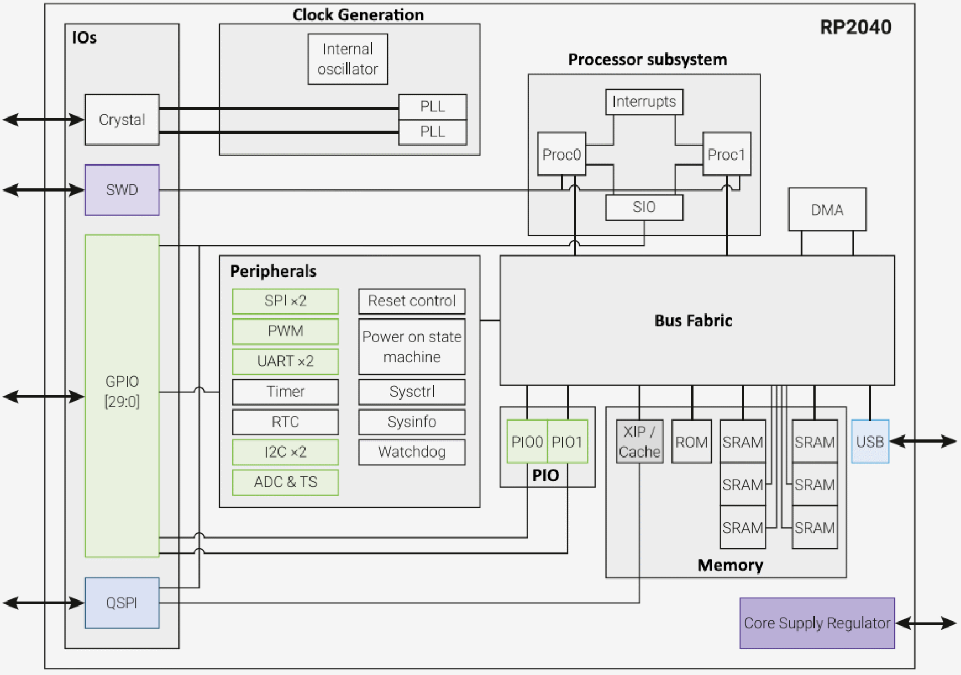
RP2040 Microcontroller - Architecture
Cores
Each PIO block has dedicated connections to the bus fabric, GPIO and interrupt controller.

Slide 58
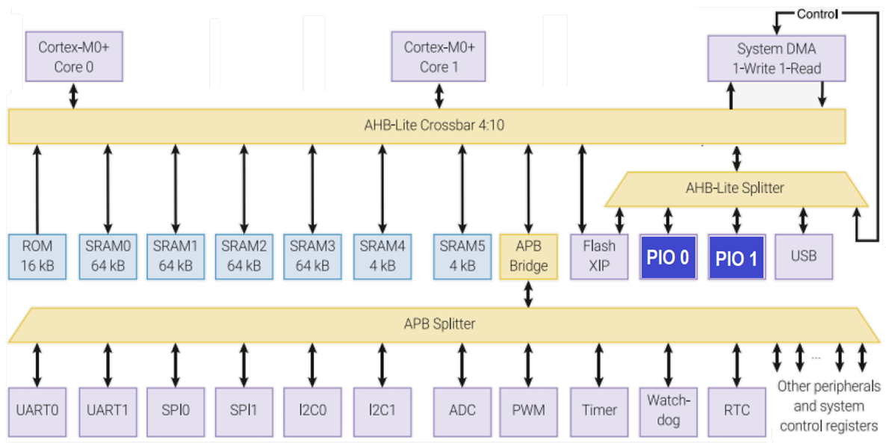
The high-level structure of the RP2040 bus fabric
PIO is programmable in the same sense as a processor.
There are 2 identical PIO blocks in RP2040.
Notes:
The main AHB-Lite crossbar routes addresses and data between its 4 upstream ports and 10 downstream ports: up to four bus transfers can take place each cycle.
All data paths are 32 bits wide.
Memory devices have dedicated ports on the main crossbar, to satisfy their high bandwidth requirements.
High-bandwidth AHB-Lite peripherals have a shared port on the crossbar, and an APB bridge provides bus access to system control registers and lower-bandwidth peripherals.

Slide 59
PIO Blocks
Unlike a general-purpose processor, PIO state machines are highly specialized for IO, with a focus on :
determinism,
precise timing, and
Close integration with fixed-function hardware.
At each system clock cycle, each state machine fetches, decodes, and executes an instruction. Each state machine is used to manipulate GPIOs and transfer data with no CPU intervention.

Slide 60
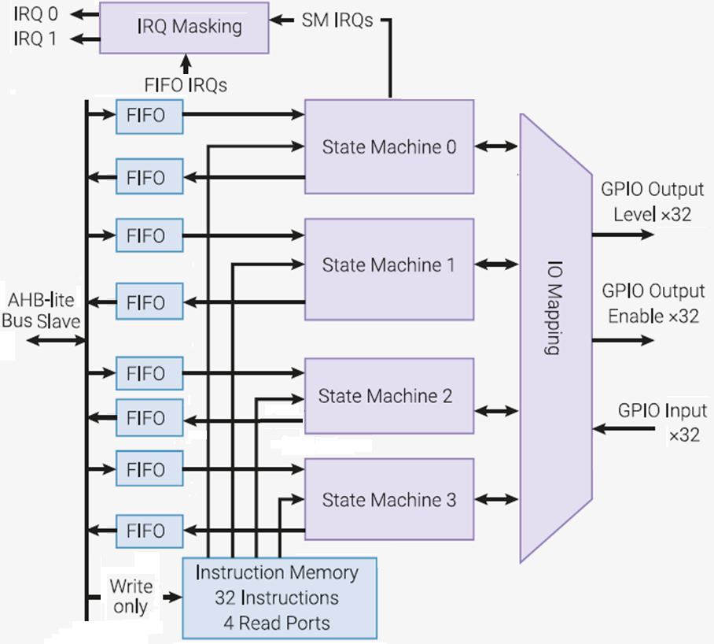
PIO Block
Each PIO block consists of 4 state machines(SMs),
They can independently execute sequential programs, to control any of the GPIO pins on the Pico and transfer data.

Slide 61
PIO Block
The instruction memory can hold 32 word(16bit) shared instructions and each state machine can utilize any of the said instructions.
4×32-bit bus FIFO in each direction (TX/RX), reconfigurable as 8×32 in a single direction.

Slide 62
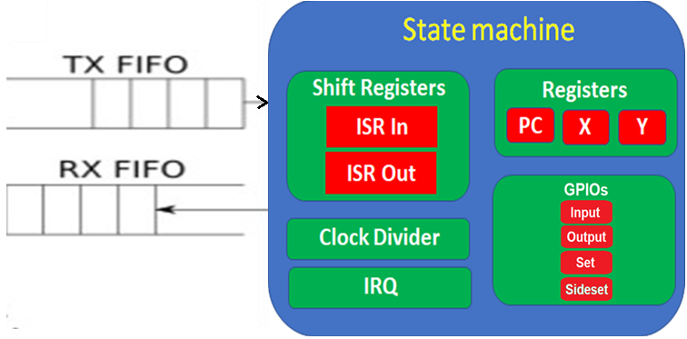
Statemachine
Each state machine (SM) has five registers which are all 32-bits in size:
The program counter, points to the currently executing instruction in the instruction memory.
Two 32-bit Scratch registers X and Y.
Two 32-bit Shift registers: The input shift register(ISR), and the output shift register(OSR). Both of these are connected to the FIFOs.

Slide 63
PIO Blocks
The clock divider is directly connected to the system clock and can divide the system clock (133 MHz) by 1 to 65536, with a fractional precision of 1/256.
The state machine is also connected to the IRQ system, for synching state machines and alerting the CPU later on with IRQ flag set/clear/status.

Slide 64
Statemachine
The SM machine can control all 30 GPIOs, setting pin direction and output or reading input. Flexible GPIO mapping.
Each state machine has access to GPIOs – via 4 different IO mappings: Input pins, Output pins, Set pins and Sideset pins.
DMA interface, sustained throughput up to 1 word per clock from system DMA.

Slide 65
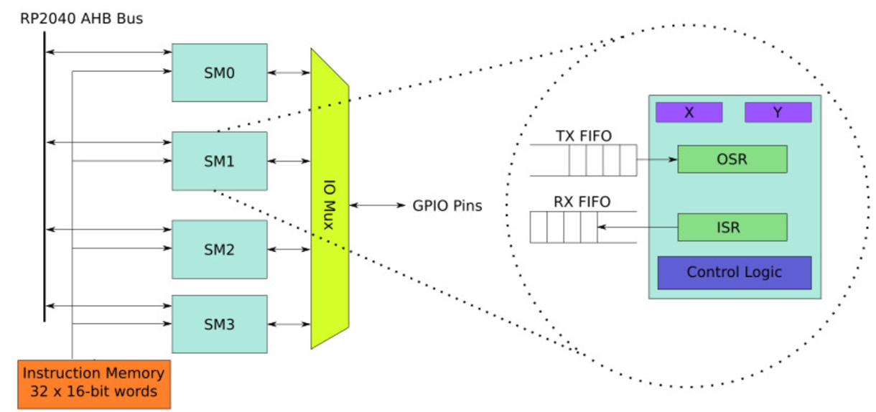
PIO Blocks
A special assembly language is introduced to program PIO units
PIO allows same cost and power envelope compared to a fully configurable logic fabric like a CPLD.

Slide 66
PIO assembly language
-- The assembly language: Instructions are 16-bit and there are 9 types:
OUT- shift bits from the OSR into a destination, such as pin outputs or the X or Y scratch registers.
IN - The opposite of OUT, shifting from sources such as pin inputs or the X or Y scratch registers into the ISR.
PULL - pops the front element of the output FIFO into the OSR. Waits if the output FIFO is empty.
PUSH - pushes the contents of the ISR into the input FIFO and clears the ISR. Waits if the input FIFO is full.

Slide 67
PIO assembly language
-- The assembly language: (Contd….)
MOV - Moves from a source to a destination. Can use registers and pins as both a source and destination as well as a couple of places with special functionality.
JMP - Branches to a different instruction, can be conditional on a few conditions (such as X or Y zero or not-zero) and decrement X or Y.
IRQ - Raises an interrupt (which can interrupt one of the cores or be used to synchronize SMs).
WAIT - Can wait for various things like a pin changing state or an interrupt occurring.
SET - Writes an immediate value to X, Y or the pins

Slide 68
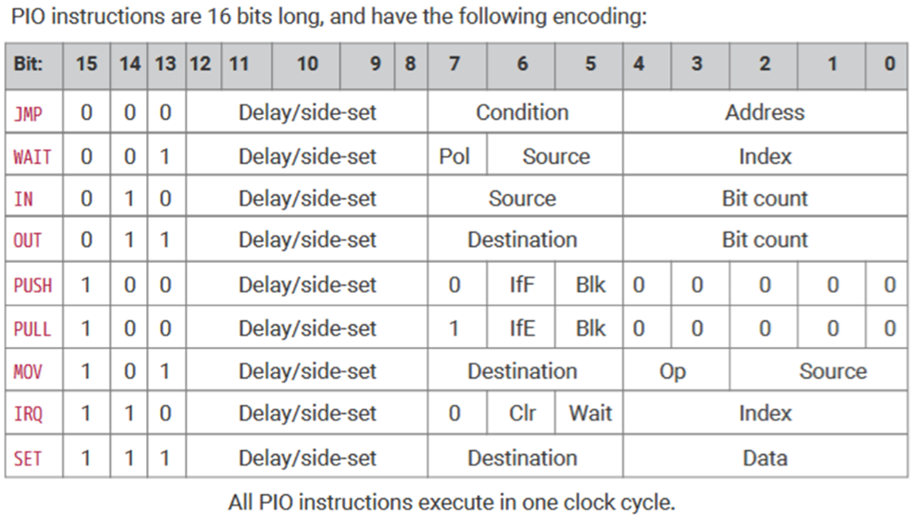
PIO Assembly Instructions / Encoding

Slide 69
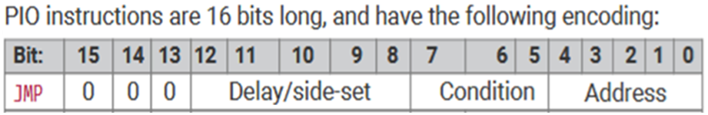
PIO Assembly Language
Program memory is only 32 instructions long, but each instruction can have several simultaneous effects,
a variable delay after execution (for pulse length trimming),
the ability to set/clear a group of pins(side-set), and,
of course, the main opcode function.
Some instructions can also be set up to auto-pull or auto-push the i/o FIFOs at the same time they perform other functions.
An extra SPI channel takes 5 instructions, PWM takes 7, VGA takes ~30.

Slide 70
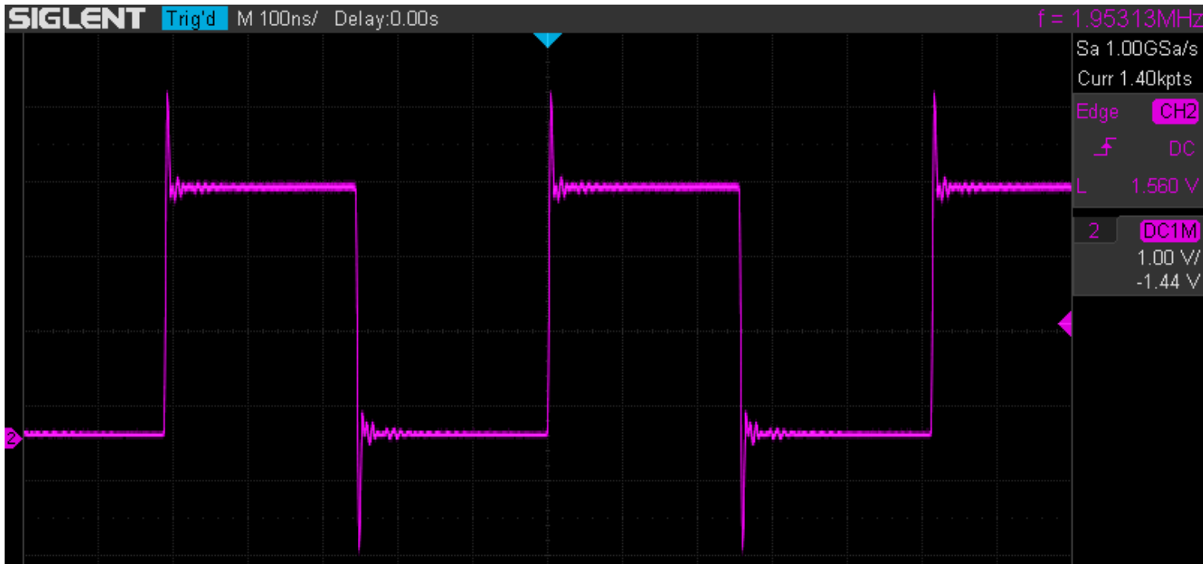
Example: Generating a Square wave
The system clock frequency is 125 MHz by default on the RP2040.
A state machine is programmed so that it sets the output to its high state for 32 cycles or 256 ns (1 cycle = 1/125000000 Hz = 8 ns) and then it sets the output to its low state for 32 cycles as well. The square wave frequency will therefore be 1.953 MHz.
We observe a square signal of frequency 1.953 MHz at the output of pin 34 (GP28) of the Pico.

Slide 71
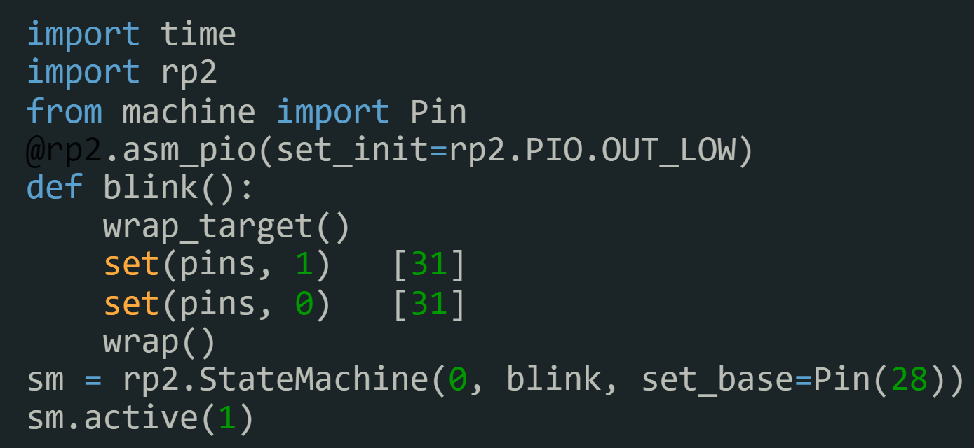
Example: Generating a Square wave
The state machine program :
wrap_target() : Specifies the start location of the program loop.
set(pins, 1) [1] : Sets the output to the high state (instruction executed in 1 cycle) and remains in this state for 31 cycles. This step therefore lasts 32 cycles.
set(pins, 0) [1] : Sets the output to the low state (instruction executed in 1 cycle) and remains in this state for 31 cycles. This step therefore also lasts 32 cycles.
wrap() : Specifies where the program loop ends.

Slide 72
import time
from rp2 import PIO, asm_pio
from machine import Pin
#
@asm_pio(set_init=rp2.PIO.OUT_LOW)
def blink():
wrap_target()
set(pins, 1) [1]
set(pins, 0) [1]
wrap()
# Instantiate a state machine with the blink program, at 100MHz, with set bound to Pin(15)
sm = rp2.StateMachine(0, blink, freq=100000000,set_base=Pin(15))
# Run the state machine for 3 seconds and scope pin 15.
sm.active(1)
time.sleep(3)
sm.active(0)
If stripped down to see how fast the simplest example program would toggle a pin.
The original example blinks the LED at a human rate.
The clock frequency of the state machine can be set as high as 125 MHz (the system clock frequency).
The set commands set/clear a pin,
The result is one state machine cycle for each set, followed by a one cycle delay after each set, for a loop-time of 4 cycles.
At 100 MHz, that is a 25 MHz squarewave.
If you delete the two [1] delays, the frequency will be 50 MHz.
Delay parameter
Zero time unconditional
jump

Slide 73
Hands-on Session

Slide 74
Blink LED using PIO
Prog-7
import machine
import time
import rp2
# Single pin (base pin) starts at output and logic low
@rp2.asm_pio(set_init=rp2.PIO.OUT_LOW)
def blink():
wrap_target()
set(pins, 1) [31]
nop() [31]
nop() [31]
nop() [31]
nop() [31]
set(pins, 0) [31]
nop() [31]
nop() [31]
nop() [31]
nop() [31]
wrap()
# Init state machine with "blink" program
# (state machine 0, running at 2kHz, base pin is #GP2 (LED))
sm = rp2.StateMachine(0, blink, freq=2000, set_base=machine.Pin(2))
sm.active(1) # Start State Machine 0
#time.sleep(3)
#sm.active(0) # Start State Machine 1
32*5*0.5 ms = 80 ms

Slide 75
Prog-8
from machine import Pin
import rp2
@rp2.asm_pio(set_init=rp2.PIO.OUT_LOW)
def blink_1hz():
# Cycles: 1 + 7 + 32 * (30 + 1) = 1000
set(pins, 1)
set(x, 31) [6]
label("delay_high")
nop() [29]
jmp(x_dec, "delay_high")
# Cycles: 1 + 7 + 32 * (30 + 1) = 1000
set(pins, 0)
set(x, 31) [6]
label("delay_low")
nop() [29]
jmp(x_dec,"delay_low")
sm = rp2.StateMachine(0, blink_1hz, freq=2000, set_base=Pin(2))
sm.active(1)

Slide 76

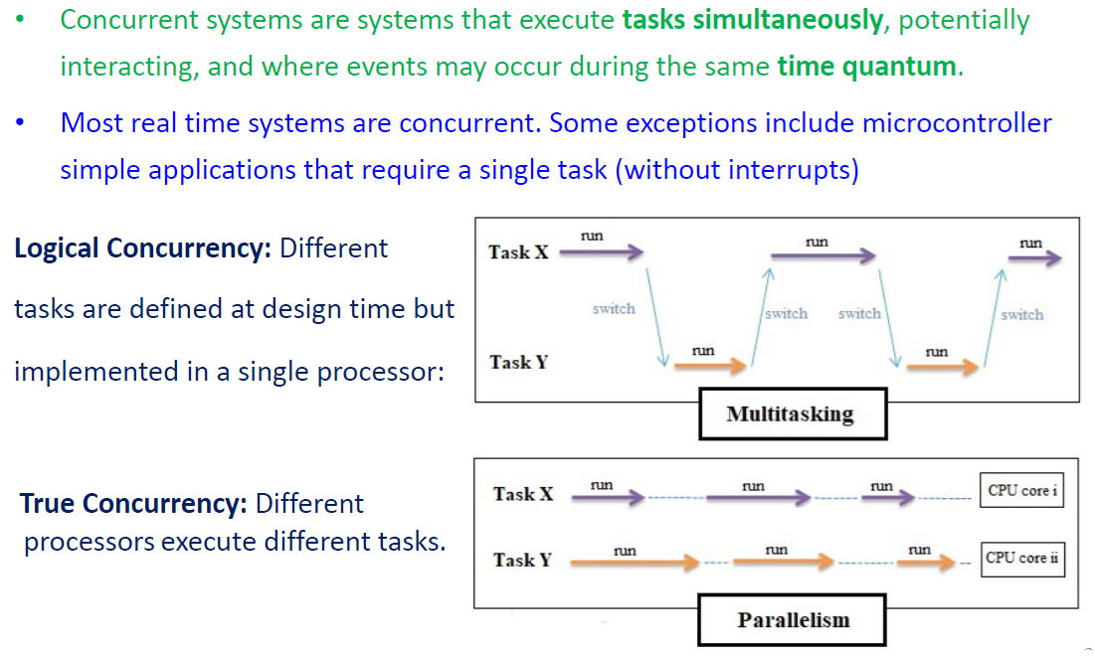

Slide 77
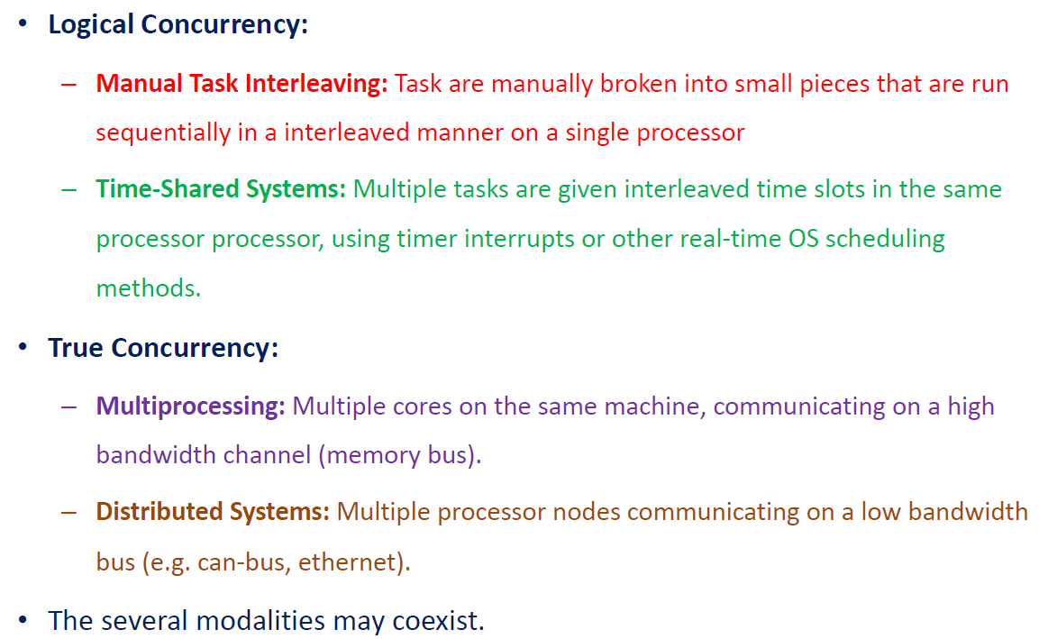

Slide 78

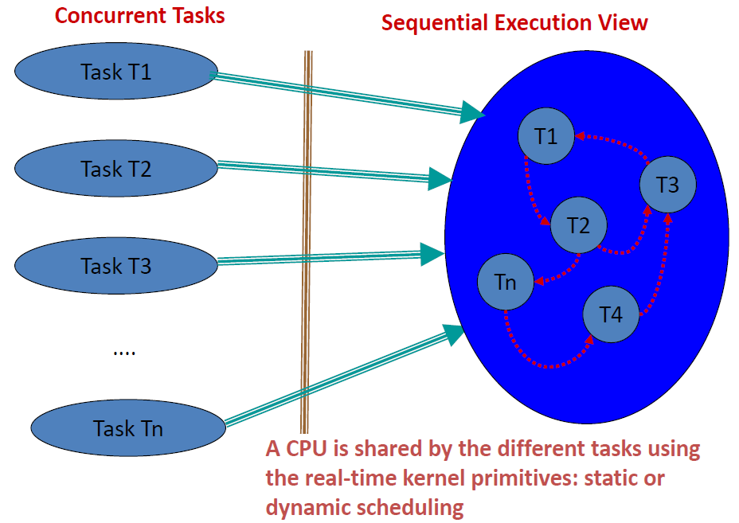

Slide 79

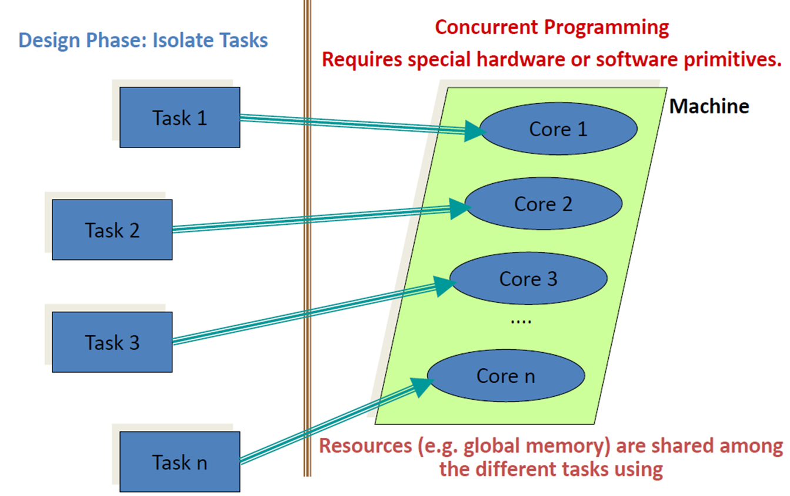

Slide 80
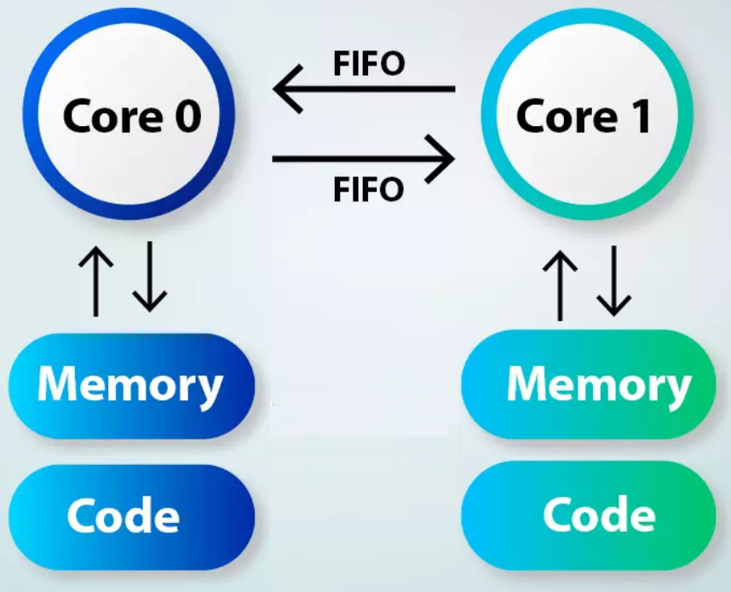
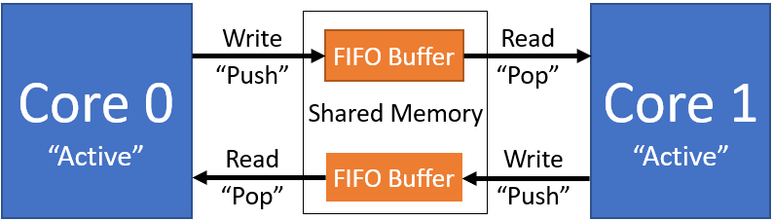
Raspberry Pi Pico Dual Core Programming
Each core separately runs its own code independently.
Both have separate program code and memory space. However, the cores can also share program code and memory space.
Fetching code is a read instruction and it does not create a race condition.
Sharing the same location for data, however, creates a possibility for a race condition to exist where mutual accesses to the memory is not assured. So the cores should not share memory directly.
Only one FIFO is writable by core0 and only one FIFO is writable by core1. This way no core is writing to the same location at the same time.

Slide 81
Hands-on Session

Slide 82
Multithreading using Dual Core Programming
Prog-9
from machine import Pin
import time
import _thread
led1=Pin(2,Pin.OUT)
led2=Pin(3,Pin.OUT)
def second_core_function():
while(1):
led2.toggle()
time.sleep(0.5)
_thread.start_new_thread(second_core_function, ())
while True:
led1.toggle()
time.sleep(1)

Slide 83
Multithreading using Dual Core Programming
Prog-10
from machine import Pin
import time
import _thread
# sLock = _thread.allocate_lock()
def second_core_function():
while(1):
for x in range(5):
print("core1",x)
time.sleep(0.5)
_thread.start_new_thread(second_core_function, ())
while True:
for x in range(5):
print("core0",x)
time.sleep(1)

Slide 84
from machine import Pin
import time
import _thread
led1 = Pin(2, machine.Pin.OUT)
led2 = Pin(3, machine.Pin.OUT)
sLock = _thread.allocate_lock()
def CoreTask():
while True:
sLock.acquire()
for x in range(5):
print("coreS",x)
print(x)
time.sleep(1)
sLock.release()
_thread.start_new_thread(CoreTask())
Prog-10 Modified
while True:
sLock.acquire() # Acquire the semaphore lock
for x in range(5):
print("coreM",x)
print(x)
time.sleep(1)
sLock.release() # Release the semaphore lock

Slide 85
Prog-11
from machine import Pin
import utime
import _thread
led1 = Pin(2, machine.Pin.OUT)
led2 = Pin(3, machine.Pin.OUT)
sLock = _thread.allocate_lock()
def CoreTask():
while True:
sLock.acquire()
print("Entered into the 2nd Thread")
utime.sleep(1)
led2.high()
print("Led 2 turned on")
utime.sleep(2)
led2.low()
print("Led 2 turned off")
utime.sleep(1)
print("Exiting from the 2nd Thread")
utime.sleep(1)
sLock.release()
_thread.start_new_thread(CoreTask, ())
while True:
sLock.acquire()
print("Entered into the main Thread")
led1.toggle()
utime.sleep(0.15)
print("Led 1 started to toggle.")
utime.sleep(1)
print("Exiting from the main Thread")
utime.sleep(1)
sLock.release() # Release the lock

Slide 86
Waiting for a Serial Port
Say I’ve got two tasks that can write to a serial port (using printf()* let’s say).
They are writing messages to a terminal.
If one is in the middle of a message, I can’t preempt it with another that can/will write to the serial port.
My message will be jumbled as one message hits the middle of the other.
This can happen with all kinds of resources including other ports (e.g. I2C, USB) and timers
Common to have a shared data structure where if one task is writing, no task can use it.
Why might someone else not be able to read?
*The standard version of printf is not “reentrant”. This is a good thing to know (and understand)
Notes:
Read issue: data structure may not be in a safe state. Consider a tree where it’s not a tree for part of an insertion.

Slide 87
Prog-12
from time import sleep
import _thread
def core0_thread():
while True:
print('C')
sleep(0.5)
print('O')
sleep(0.5)
print('R')
sleep(0.5)
print('E')
sleep(0.5)
print('0')
sleep(0.5)
def core1_thread():
while True:
print('c')
sleep(0.5)
print('o')
sleep(0.5)
print('r')
sleep(0.5)
print('e')
sleep(0.5)
print('1')
sleep(0.5)
second_thread = _thread.start_new_thread(core1_thread, ())
core0_thread()

Slide 88
Prog-13
from time import sleep
import _thread
spLock = _thread.allocate_lock()
def core0_thread():
while True:
spLock.acquire()
print('C')
sleep(0.5)
print('O')
sleep(0.5)
print('R')
sleep(0.5)
print('E')
sleep(0.5)
print('0')
sleep(0.5)
spLock.release()
def core1_thread():
while True:
spLock.acquire()
print('c')
sleep(0.5)
print('o')
sleep(0.5)
print('r')
sleep(0.5)
print('e')
sleep(0.5)
print('1')
sleep(0.5)
spLock.release()
second_thread = _thread.start_new_thread(core1_thread, ())
core0_thread()

Slide 89


